Slide 1

DETECTING ACCIDENT HOTSPOTS USING SPATIAL DATA
SUBMITTED BY:
RHYTHM MALHOTRA 16103156
SHREYAS JAIN 16103200
SHRUTI PANDEY 16103230

Slide 2
Contents:
Introduction
Purpose of project
Solution Description
Solution Flowchart
Output
Conclusion

Slide 3
INTRODUCTION
One of the most common causes of loss of human life are road accidents. One way to prevent it is to detect the areas that see a high number of accidents and provide suitable measures in these areas for their prevention. These places are called “black spots” or “hotspots”.
Various methods are present that can be used to detect hotspots. One such method is the geostatistical technique that uses spatial data. Spatial data is being used more and more widely used for various applications in different sectors such as thefts, traffic jams, accidents, or a particular disease spread across the map.
To determine hotspots in a spatial dataset, clustering of points is required.

Slide 4
PURPOSE
The purpose here is to build a system that helps identify significant accident hotspots in the areas the data of which is provided. Using the past raw data of accidents, we intend to determine which geographical areas are more prone to accidents than others.
Using this information, important steps like deploying more police force in those hotspots and decisions of constructing bridges etc. can be taken in order to reduce the damage caused by those accidents.
We present a solution to locate high density accident hotspots which may determine causal indicators more likely to be present at certain clusters. By identifying such points we can take necessary precautions and safety measures at those places. The local governmental policy can focus on the traffic in that community and neighbourhood.

Slide 5
SOLUTION APPROACH
We intend to classify accident hotspots using clustering methods. We apply two clustering algorithms - DBSCAN and OPTICS.
To determine hotspots in a spatial dataset, clustering of points is required, but clustering results are not always accurate. Some output clusters might be a simple result of coincidence. For this purpose we apply significant testing
For significant testing we apply Monte Carlo Estimation using which we find a threshold cluster size to classify a cluster as significant or not.

Slide 6
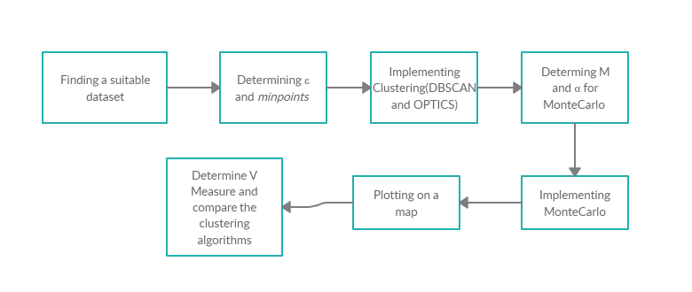
SOLUTION FLOWCHART

Slide 7
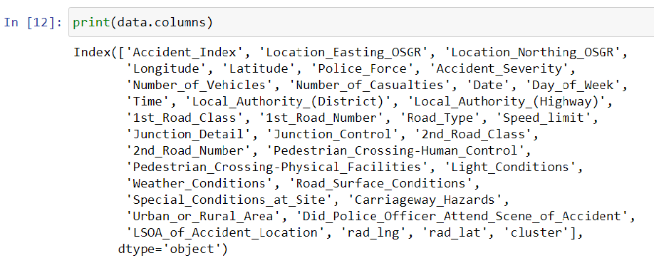
DESCRIPTION OF SOLUTION
Dataset:
Source: Official yearly road safety and accident data published by the Department of Transport, U.K. Government.
Time Span: Data of 4 consecutive years from 2015 to 2018 is taken in account.
Attributes of the data: Location(latitude, longitude), date and time of accident, accident severity, no. of casualties, police force involvement or not, etc.
Overall size: 561689 rows and 32 columns.

Slide 8
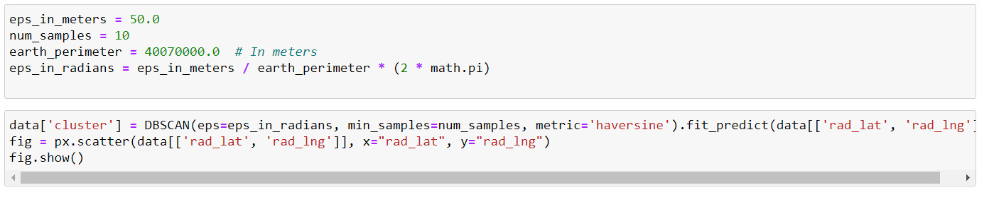
DBSCAN:
Identifies clusters irrespective of shape and sizes.
Robust to outliers. (eliminates them as noise)
Categorises a point as core point, border point or noise based on parameter values.
Two parameters: ε and minpoints.
ε: specifies how close points should be to each other to be considered a part of a cluster.
minpoints: the minimum number of points to form a dense region.
DBCAN is very sensitive to parameter values, crucial to determine appropriate values.
For our project. ε= 50m. minpoints: 10. Determined by hitting and trying several values, observing change in number of clusters.

Slide 9
Implemented in our project using sklearn library in python
Time Complexity: O(nlogn)
DBSCAN might not perform well when there are clusters that have non-uniform density.

Slide 10
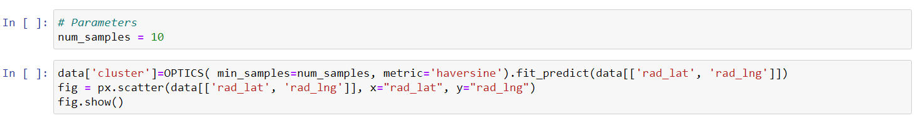
OPTICS:
Basic idea is similar to DBSCAN
It creates a reachability plot that is then used to extract clusters or other dataset analysis
OPTICS doesn’t requires two parameters like DBSCAN, ε and minpoints.
Parameters don’t have as big an effect as their counterparts in other clustering algorithms, and are much easier to use defaults.
Core Distance: The minimum value of radius required to classify a given point as a core point.
Reachability Distance: - The reachability-distance of an object p with respect to another object o is the smallest distance from o if o is a core object. It cannot be smaller than the core distance of o.

Slide 11
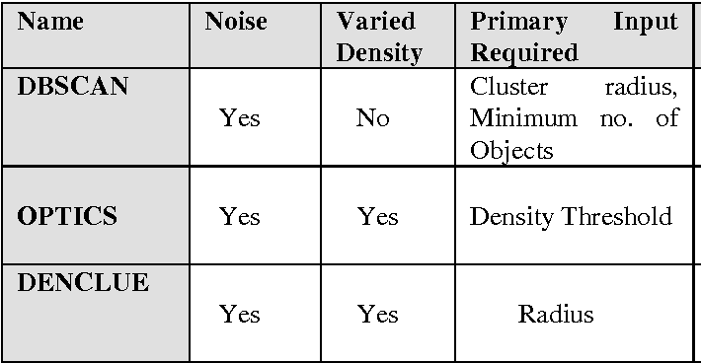
Addresses one of DBSCAN’s major weaknesses: the problem of detecting meaningful clusters in data of varying density.
Time Complexity: O(nlogn)+O(n).
Implemented in our project using sklearn library.

Slide 12
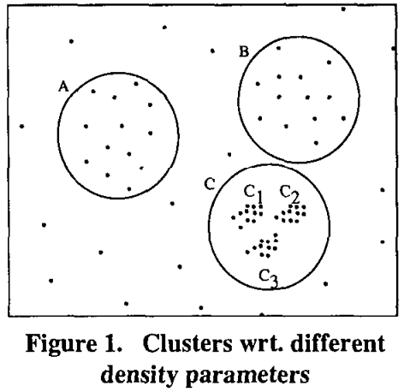
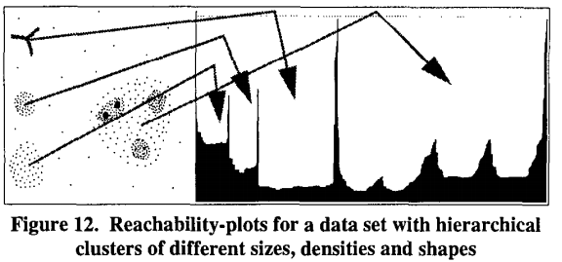

Slide 13
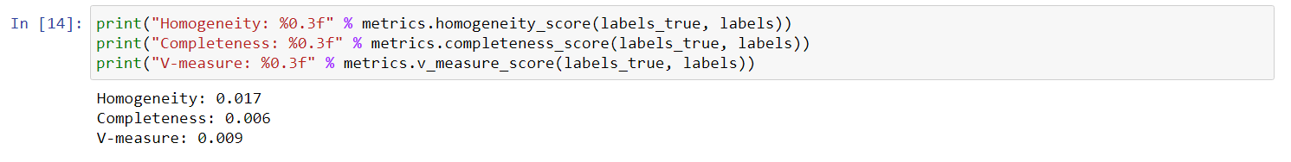
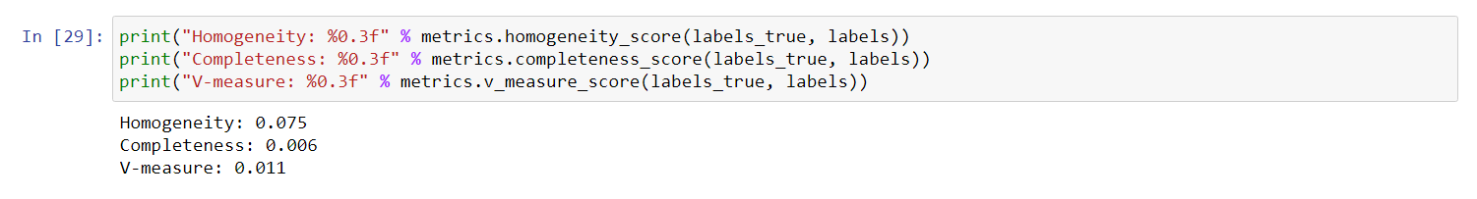
V-Measure:
An external entropy based cluster evaluation measure.
it is independent of the number of class labels, the number of clusters, the size of the data and the clustering algorithm used.
Combination of two desirable aspects of clustering, homogeneity and completeness.
Obtained V-Measure of OPTICS is greater than that of DBSCAN
Greater the V-Measure, more the closeness of the clustering algorithm to this perfection.

Slide 14
Monte Carlo algorithm:
In our project, no. of clusters is chosen test statistic. (does not require area of clusters).
Value of M(no of iterations): 1000, α(Significance level): 0.02 .
In each iteration, a random point distribution is generated and the maximum value of test statistic is determined, the values are then sorted and the rank(r) of the cluster to be judged is determined.
When r < Mα, cluster is significant, otherwise not.

Slide 15
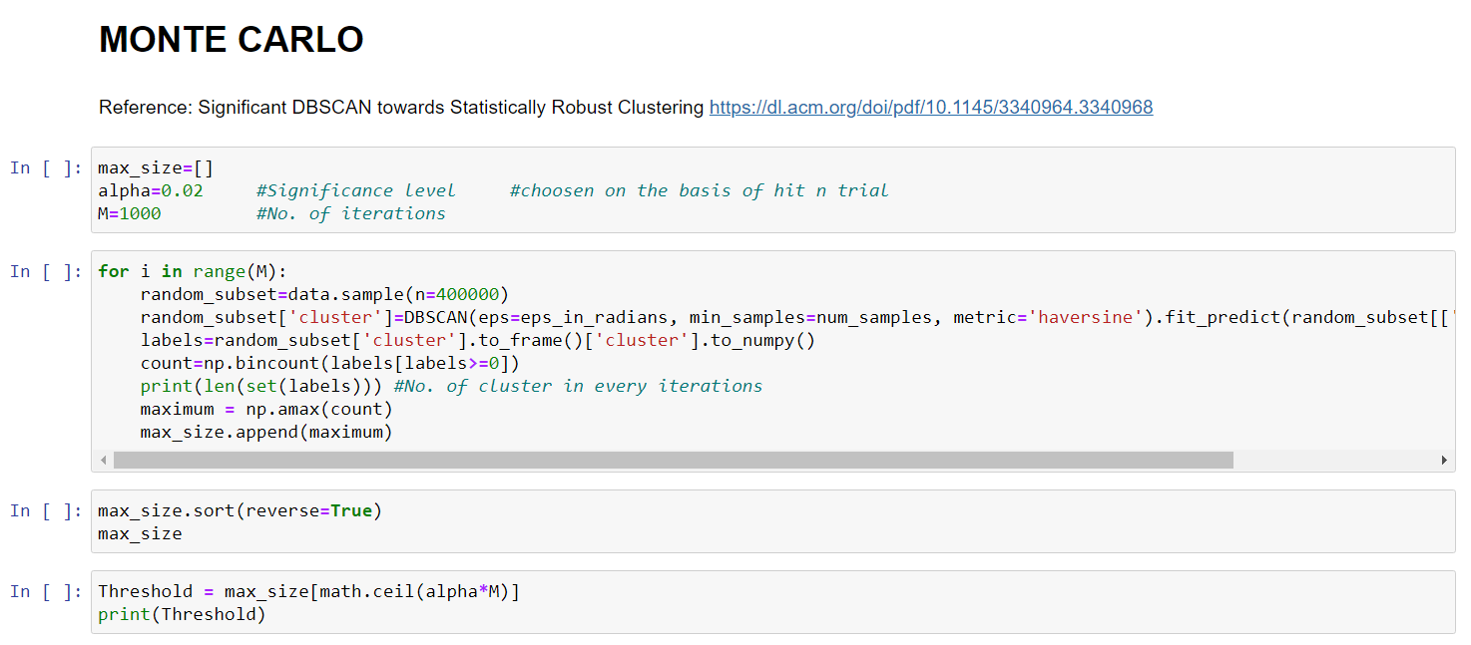

Slide 16
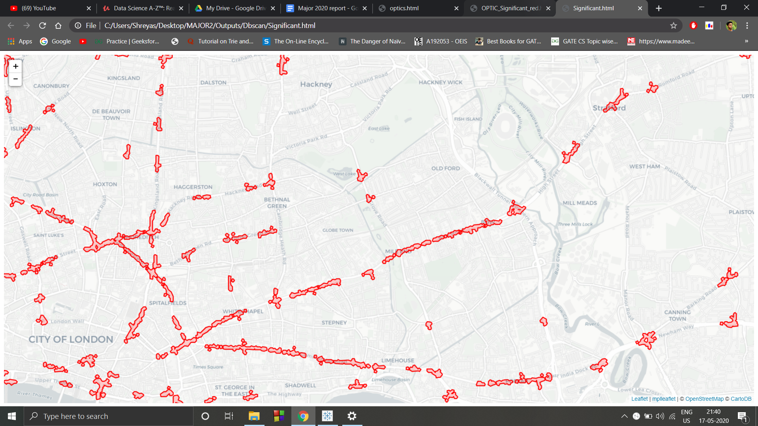
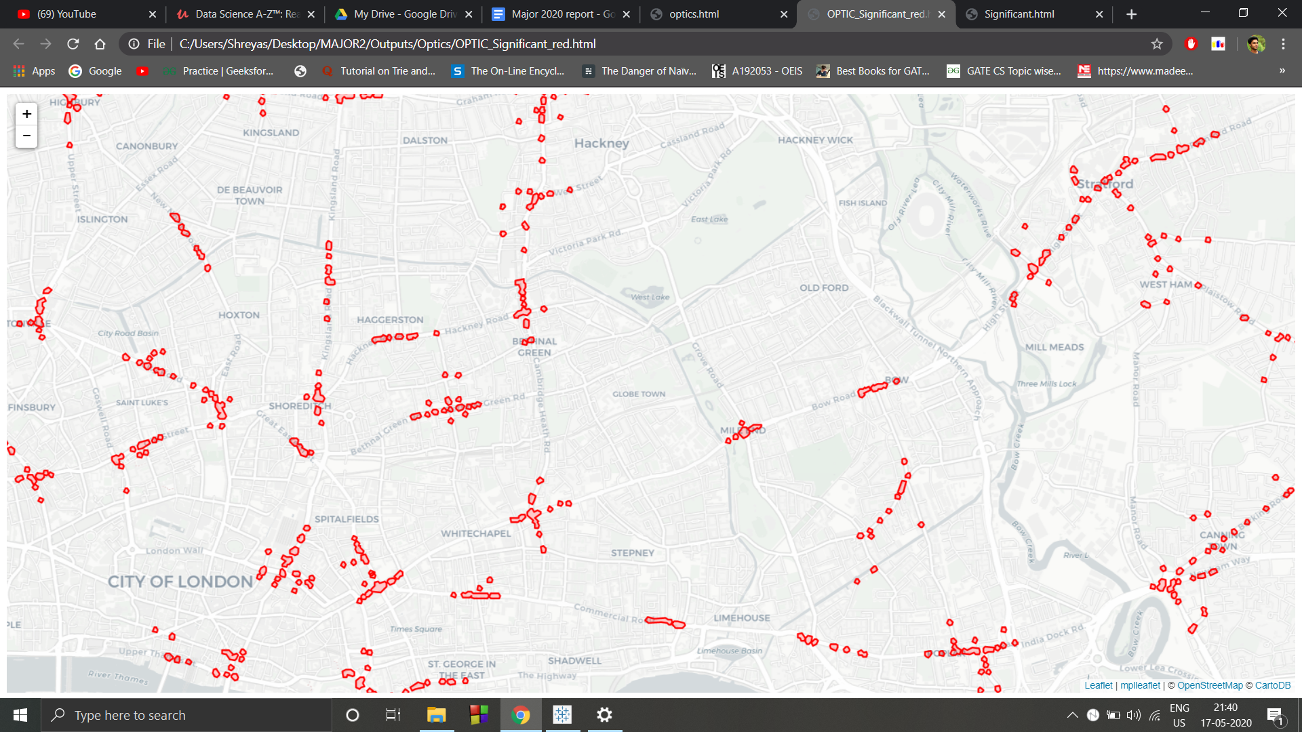
Outputs:
DBSCAN Clusters after Significant Testing OPTICS clusters after significant testing

Slide 17
CONCLUSION
The leading cause of deaths in the world is road accidents. This project aims at decreasing this by recognising the areas which have the most frequency of these mishaps.
In our project, V-Measure value of OPTICS is obtained to be greater than DBSCAN.
OPTICS has higher computational complexity compared to DBSCAN
We also analyse the dataset in terms of various attributes of accidents with respect to others, to deduce further information.
Significant hotspots plot on a map are very helpful and can be easily studied by laymen.
By identifying such points we can take necessary precautions and safety measures at those places. The local governmental policy can focus on the traffic in that community and neighbourhood. Also, this might allow for a greater neighbourhood participation in understanding road user risk and make them more careful.

